Slide 1
Minimum Spanning Trees

Slide 2
Minimum Spanning Tree Say we have an undirected weighted graph
8
7
B
C
D
4
9
2
11
4
A
I
14
E
7
6
8
10
1
2
A tree is a connected graph with no cycles!
H
G
F
A spanning tree is a tree that connects all of the vertices.

Slide 3
Minimum Spanning Tree Say we have an undirected weighted graph
The cost of a spanning tree is the sum of the weights on the edges.
This is a spanning tree.
8
7
B
C
D
It has cost 67
4
9
2
11
4
A
I
14
E
7
6
8
10
1
2
A tree is a connected graph with no cycles!
H
G
F
A spanning tree is a tree that connects all of the vertices.

Slide 4
Minimum Spanning Tree Say we have an undirected weighted graph
8
7
This is also a spanning tree.
B
C
D
It has cost 37
4
9
2
11
4
A
I
14
E
7
6
8
10
1
2
A tree is a connected graph with no cycles!
H
G
F
A spanning tree is a tree that connects all of the vertices.

Slide 5
Minimum Spanning Tree Say we have an undirected weighted graph
8
7
B
C
D
4
9
2
11
4
A
I
14
E
7
6
8
10
1
2
H
G
F
minimum
of minimal cost
A spanning tree is a tree that connects all of the vertices.

Slide 6
Minimum Spanning Tree Say we have an undirected weighted graph
8
7
This is a minimum spanning tree.
B
C
D
It has cost 37
4
9
2
11
4
A
I
14
E
7
6
8
10
1
2
H
G
F
minimum
of minimal cost
A spanning tree is a tree that connects all of the vertices.

Slide 7
Why MSTs?
Network design
Connecting cities with roads/electricity/telephone/…
cluster analysis
eg, genetic distance
image processing
eg, image segmentation
Useful primitive
for other graph algs
Figure 2: Fully parsimonious minimal spanning tree of 933 SNPs for 282 isolates of Y. pestis colored by location.
Morelli et al. Nature genetics 2010

Slide 8
Brief aside
for a discussion of cuts in graphs!

Slide 9
Cuts in graphs
A cut is a partition of the vertices into two parts:
8
7
B
C
D
4
9
2
11
4
A
I
14
E
7
6
8
10
1
2
H
G
F
This is the cut “{A,B,D,E} and {C,I,H,G,F}”

Slide 10
Cuts in graphs
One or both of the two parts might be disconnected.
8
7
B
C
D
4
9
2
11
4
A
I
14
E
7
6
8
10
1
2
H
G
F
This is the cut “{B,C,E,G,H} and {A,D,I,F}”

Slide 11
Let S be a set of edges in G
We say a cut respects S if no edges in S cross the cut.
An edge crossing a cut is called light if it has the smallest weight of any edge crossing the cut.
8
B
C
D
7
4
9
2
11
4
A
I
14
E
7
6
8
10
1
2
H
G
F
S is the set of thick orange edges

Slide 12
Let S be a set of edges in G
We say a cut respects S if no edges in S cross the cut.
An edge crossing a cut is called light if it has the smallest weight of any edge crossing the cut.
This edge is light
8
B
C
D
7
4
9
2
11
4
A
I
14
E
7
6
8
10
1
2
H
G
F
S is the set of thick orange edges

Slide 13
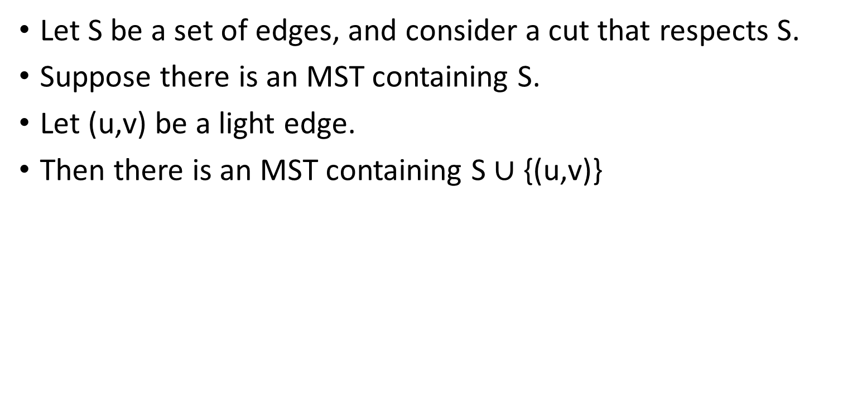
Lemma
Let S be a set of edges, and consider a cut that respects S.
Suppose there is an MST containing S.
Let (u,v) be a light edge.
Then there is an MST containing S $∪$ {(u,v)}
This edge is light
B
8
C
D
7
4
9
2
11
4
A
I
14
E
8
7
6
10
H
1
G
2
F
S is the set of thick orange edges

Slide 14
Lemma
Let S be a set of edges, and consider a cut that respects S.
Suppose there is an MST containing S.
Let (u,v) be a light edge.
Then there is an MST containing S $∪$ {(u,v)}
Aka:
If we haven’t ruled out the possibility of success so far, then adding a light edge still won’t rule it out.
It’s ”safe” to add this edge!
B
8
C
D
7
4
9
2
11
4
A
I
14
E
8
7
6
10
H
1
G
2
F
S is the set of thick orange edges

Slide 15
Proof of Lemma
Assume that we have:
a cut that respects S
x
y
u
a
v
b

Slide 16
Proof of Lemma
Assume that we have:
a cut that respects S
S is part of some MST T.
Say that (u,v) is light.
lowest cost crossing the cut
x
y
u
a
v
b

Slide 17
Proof of Lemma
Claim: Adding any additional edge to a spanning tree will create a cycle.
Proof: Both endpoints are already in the tree and connected to each other.
Assume that we have:
a cut that respects S
S is part of some MST T.
Say that (u,v) is light.
lowest cost crossing the cut
But say (u,v) is not in T.
So adding (u,v) to T
will make a cycle.
x
y
Otherwise we’re done!
u
a
v
b

Slide 18
Proof of Lemma
Claim: Adding any additional edge to a spanning tree will create a cycle.
Proof: Both endpoints are already in the tree and connected to each other.
Assume that we have:
a cut that respects S
S is part of some MST T.
Say that (u,v) is light.
lowest cost crossing the cut
But say (u,v) is not in T.
So adding (u,v) to T
will make a cycle.
So there is at least one other edge in this cycle crossing the cut.
call it (x,y)
x
y
u
a
v
b

Slide 19
Proof of Lemma ctd.
Consider swapping (u,v) for (x,y) in T.
Call the resulting tree T’.
x
y
u
a
v
b

Slide 20
Proof of Lemma ctd.
Consider swapping (u,v) for (x,y) in T.
Call the resulting tree T’.
Claim: T’ is still an MST.
It is still a tree:
we deleted (x,y)
It has cost at most that of T
because (u,v) was light.
T had minimal cost.
So T’ does too.
x
y
u
a
So T’ is an MST containing (u,v).
This is what we wanted.
v
b

Slide 21
Lemma
Let S be a set of edges, and consider a cut that respects S.
Suppose there is an MST containing S.
Let (u,v) be a light edge.
Then there is an MST containing S $∪$ {(u,v)}
This edge is light
B
8
C
D
7
4
9
2
11
4
A
I
14
E
8
7
6
10
H
1
G
2
F
S is the set of thick orange edges

Slide 22
End aside
Back to MSTs!

Slide 23
Back to MSTs
How do we find one?
Today we’ll see two greedy algorithms.
The strategy:
Make a series of choices, adding edges to the tree.
Show that each edge we add is safe to add:
we do not rule out the possibility of success
we will choose light edges crossing cuts and use the Lemma.
Keep going until we have an MST.

Slide 24
Prim’s Algorithm
Minimum Spanning Tree

Slide 25
Idea 1 Start growing a tree, greedily add the shortest edge we can to grow the tree.
8
7
B
C
D
4
9
2
11
4
A
I
14
E
7
6
8
10
1
2
H
G
F

Slide 26
Idea 1 Start growing a tree, greedily add the shortest edge we can to grow the tree.
8
7
B
C
D
4
9
2
11
4
A
I
14
E
7
6
8
10
1
2
H
G
F

Slide 27
Idea 1 Start growing a tree, greedily add the shortest edge we can to grow the tree.
8
7
B
C
D
4
9
2
11
4
A
I
14
E
7
6
8
10
1
2
H
G
F

Slide 28
Idea 1 Start growing a tree, greedily add the shortest edge we can to grow the tree.
8
7
B
C
D
4
9
2
11
4
A
I
14
E
7
6
8
10
1
2
H
G
F

Slide 29
Idea 1 Start growing a tree, greedily add the shortest edge we can to grow the tree.
8
7
B
C
D
4
9
2
11
4
A
I
14
E
7
6
8
10
1
2
H
G
F

Slide 30
Idea 1 Start growing a tree, greedily add the shortest edge we can to grow the tree.
8
7
B
C
D
4
9
2
11
4
A
I
14
E
7
6
8
10
1
2
H
G
F

Slide 31
Idea 1 Start growing a tree, greedily add the shortest edge we can to grow the tree.
8
7
B
C
D
4
9
2
11
4
A
I
14
E
7
6
8
10
1
2
H
G
F

Slide 32
Idea 1 Start growing a tree, greedily add the shortest edge we can to grow the tree.
8
7
B
C
D
4
9
2
11
4
A
I
14
E
7
6
8
10
1
2
H
G
F

Slide 33
Idea 1 Start growing a tree, greedily add the shortest edge we can to grow the tree.
8
7
B
C
D
4
9
2
11
4
A
I
14
E
7
6
8
10
1
2
H
G
F

Slide 34
We’ve discovered Prim’s algorithm!
slowPrim( G = (V,E), starting vertex s ):
Let (s,u) be the lightest edge coming out of s.
MST = { (s,u) }
verticesVisited = { s, u }
while |verticesVisited| < |V|:
find the lightest edge (x,v) in E so that:
x is in verticesVisited
v is not in verticesVisited
add (x,v) to MST
add v to verticesVisited
return MST
n iterations of this while loop.
Maybe take time m to go through all the edges and find the lightest.
Naively, the running time is O(nm):
For each of n-1 iterations of the while loop:
Maybe go through all the edges.

Slide 35
Two questions
Does it work?
That is, does it actually return a MST?
How do we actually implement this?
the pseudocode above says “slowPrim”…

Slide 36
Does it work?
We need to show that our greedy choices don’t rule out success.
That is, at every step:
There exists an MST that contains all of the edges we have added so far.
Now it is time to use our lemma!

Slide 37
Lemma
Let S be a set of edges, and consider a cut that respects S.
Suppose there is an MST containing S.
Let (u,v) be a light edge.
Then there is an MST containing S $∪$ {(u,v)}
This edge is light
B
8
C
D
7
4
9
2
11
4
A
I
14
E
8
7
6
10
H
1
G
2
F
S is the set of thick orange edges

Slide 38
Partway through Prim
Assume that our choices S so far are safe.
they don’t rule out success
Consider the cut {visited, unvisited}
This cut respects S.
S is the set of
edges selected so far.
8
7
B
C
D
4
9
11
2
4
A
I
14
E
8
7
6
2
10
H
G
F
1

Slide 39
Partway through Prim
Assume that our choices S so far are safe.
they don’t rule out success
Consider the cut {visited, unvisited}
S respects this cut.
The edge we add next is a light edge.
Least weight of any edge crossing the cut.
S is the set of
edges selected so far.
By the Lemma, that edge is safe.
it also doesn’t rule out success.
8
7
B
C
D
4
9
11
2
4
A
I
14
E
8
7
6
2
10
add this one next
H
G
F
1

Slide 40
Hooray!
Our greedy choices don’t rule out success.
This is enough (along with an argument by induction) to guarantee correctness of Prim’s algorithm.

Slide 41
Formally(ish)
Inductive hypothesis:
After adding the t’th edge, there exists an MST with the edges added so far.
Base case:
After adding the 0’th edge, there exists an MST with the edges added so far. YEP.
Inductive step:
If the inductive hypothesis holds for t (aka, the choices so far are safe), then it holds for t+1 (aka, the next edge we add is safe).
That’s what we just showed.
Conclusion:
After adding the n-1’st edge, there exists an MST with the edges added so far.
At this point we have a spanning tree, so it better be minimal.

Slide 42
Two questions
Does it work?
That is, does it actually return a MST?
Yes!
How do we actually implement this?
the pseudocode above says “slowPrim”…

Slide 43
How do we actually implement this?
Each vertex keeps:
the distance from itself to the growing spanning tree
how to get there.
if you can get there in one edge.
I’m 7 away.
C is the closest.
8
7
B
C
D
4
9
2
11
4
A
I
14
E
7
6
I can’t get to the tree in one edge
8
10
1
2
H
G
F

Slide 44
How do we actually implement this?
Each vertex keeps:
the distance from itself to the growing spanning tree
how to get there.
Choose the closest vertex, add it.
if you can get there in one edge.
I’m 7 away.
C is the closest.
8
7
B
C
D
4
9
2
11
4
A
I
14
E
7
6
I can’t get to the tree in one edge
8
10
1
2
H
G
F

Slide 45
How do we actually implement this?
Each vertex keeps:
the distance from itself to the growing spanning tree
how to get there.
Choose the closest vertex, add it.
if you can get there in one edge.
I’m 7 away.
C is the closest.
8
7
B
C
D
4
9
2
11
4
A
I
14
E
7
6
I can’t get to the tree in one edge
8
10
1
2
H
G
F

Slide 46
How do we actually implement this?
Each vertex keeps:
the distance from itself to the growing spanning tree
how to get there.
Choose the closest vertex, add it.
Update stored info.
if you can get there in one edge.
I’m 7 away.
C is the closest.
8
7
B
C
D
4
9
2
11
4
A
I
14
E
7
6
I’m 10 away. F is the closest.
8
10
1
2
H
G
F

Slide 47
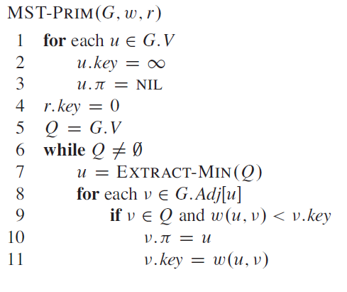
Pseudocode

Slide 48
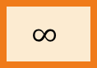


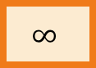


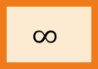
Efficient implementation Every vertex has a key and a parent
x
Can’t reach x yet
x
x is “active”
x
Can reach x
Until all the vertices are reached:
k[x]
k[x] is the distance of x from the growing tree
a
b
p[b] = a, meaning that a was the vertex that k[b] comes from.
$$∞$$
$$∞$$
$$∞$$
8
7
B
C
D
4
9
2
11
4
$$∞$$
A
I
$$∞$$
14
E
0
7
6
8
10
1
2
H
G
F
$$∞$$
$$∞$$
$$∞$$

Slide 49
Efficient implementation Every vertex has a key and a parent
x
Can’t reach x yet
x
x is “active”
x
Can reach x
Until all the vertices are reached:
Activate the unreached vertex u with the smallest key.
k[x]
k[x] is the distance of x from the growing tree
a
b
p[b] = a, meaning that a was the vertex that k[b] comes from.
$$∞$$
$$∞$$
$$∞$$
8
7
B
C
D
4
9
2
11
4
$$∞$$
A
I
$$∞$$
14
E
0
7
6
8
10
1
2
H
G
F
$$∞$$
$$∞$$
$$∞$$

Slide 50
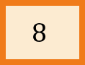
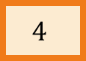
Efficient implementation Every vertex has a key and a parent
x
Can’t reach x yet
x
x is “active”
x
Can reach x
Until all the vertices are reached:
Activate the unreached vertex u with the smallest key.
for each of u’s neighbors v:
k[v] = min( k[v], weight(u,v) )
if k[v] updated, p[v] = u
k[x]
k[x] is the distance of x from the growing tree
a
b
p[b] = a, meaning that a was the vertex that k[b] comes from.
$$4$$
$$∞$$
$$∞$$
8
7
B
C
D
4
9
2
11
4
$$∞$$
A
I
$$∞$$
14
E
0
7
6
8
10
1
2
H
G
F
$$8$$
$$∞$$
$$∞$$

Slide 51
Efficient implementation Every vertex has a key and a parent
x
Can’t reach x yet
x
x is “active”
x
Can reach x
Until all the vertices are reached:
Activate the unreached vertex u with the smallest key.
for each of u’s neighbors v:
k[v] = min( k[v], weight(u,v) )
if k[v] updated, p[v] = u
Mark u as reached, and add (p[u],u) to MST.
k[x]
k[x] is the distance of x from the growing tree
a
b
p[b] = a, meaning that a was the vertex that k[b] comes from.
$$4$$
$$∞$$
$$∞$$
8
7
B
C
D
4
9
2
11
4
$$∞$$
A
I
$$∞$$
14
E
0
7
6
8
10
1
2
H
G
F
$$8$$
$$∞$$
$$∞$$

Slide 52
Efficient implementation Every vertex has a key and a parent
x
Can’t reach x yet
x
x is “active”
x
Can reach x
Until all the vertices are reached:
Activate the unreached vertex u with the smallest key.
for each of u’s neighbors v:
k[v] = min( k[v], weight(u,v) )
if k[v] updated, p[v] = u
Mark u as reached, and add (p[u],u) to MST.
k[x]
k[x] is the distance of x from the growing tree
a
b
p[b] = a, meaning that a was the vertex that k[b] comes from.
$$4$$
$$∞$$
$$∞$$
8
7
B
C
D
4
9
2
11
4
$$∞$$
A
I
$$∞$$
14
E
0
7
6
8
10
1
2
H
G
F
$$8$$
$$∞$$
$$∞$$

Slide 53
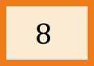
Efficient implementation Every vertex has a key and a parent
x
Can’t reach x yet
x
x is “active”
x
Can reach x
Until all the vertices are reached:
Activate the unreached vertex u with the smallest key.
for each of u’s neighbors v:
k[v] = min( k[v], weight(u,v) )
if k[v] updated, p[v] = u
Mark u as reached, and add (p[u],u) to MST.
k[x]
k[x] is the distance of x from the growing tree
a
b
p[b] = a, meaning that a was the vertex that k[b] comes from.
$$4$$
$$8$$
$$∞$$
8
7
B
C
D
4
9
2
11
4
$$∞$$
A
I
$$∞$$
14
E
0
7
6
8
10
1
2
H
G
F
$$8$$
$$∞$$
$$∞$$

Slide 54
Efficient implementation Every vertex has a key and a parent
x
Can’t reach x yet
x
x is “active”
x
Can reach x
Until all the vertices are reached:
Activate the unreached vertex u with the smallest key.
for each of u’s neighbors v:
k[v] = min( k[v], weight(u,v) )
if k[v] updated, p[v] = u
Mark u as reached, and add (p[u],u) to MST.
k[x]
k[x] is the distance of x from the growing tree
a
b
p[b] = a, meaning that a was the vertex that k[b] comes from.
$$4$$
$$8$$
$$∞$$
8
7
B
C
D
4
9
2
11
4
$$∞$$
A
I
$$∞$$
14
E
0
7
6
8
10
1
2
H
G
F
$$8$$
$$∞$$
$$∞$$

Slide 55
Efficient implementation Every vertex has a key and a parent
x
Can’t reach x yet
x
x is “active”
x
Can reach x
Until all the vertices are reached:
Activate the unreached vertex u with the smallest key.
for each of u’s neighbors v:
k[v] = min( k[v], weight(u,v) )
if k[v] updated, p[v] = u
Mark u as reached, and add (p[u],u) to MST.
k[x]
k[x] is the distance of x from the growing tree
a
b
p[b] = a, meaning that a was the vertex that k[b] comes from.
$$4$$
$$8$$
$$∞$$
8
7
B
C
D
4
9
2
11
4
$$∞$$
A
I
$$∞$$
14
E
0
7
6
8
10
1
2
H
G
F
$$8$$
$$∞$$
$$∞$$

Slide 56
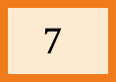
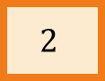
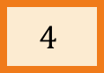
Efficient implementation Every vertex has a key and a parent
x
Can’t reach x yet
x
x is “active”
x
Can reach x
Until all the vertices are reached:
Activate the unreached vertex u with the smallest key.
for each of u’s neighbors v:
k[v] = min( k[v], weight(u,v) )
if k[v] updated, p[v] = u
Mark u as reached, and add (p[u],u) to MST.
k[x]
k[x] is the distance of x from the growing tree
a
b
p[b] = a, meaning that a was the vertex that k[b] comes from.
$$4$$
$$8$$
$$7$$
8
7
B
C
D
4
9
2
11
4
$$∞$$
A
I
$$2$$
14
E
0
7
6
8
10
1
2
H
G
F
$$8$$
$$∞$$
$$4$$

Slide 57
Efficient implementation Every vertex has a key and a parent
x
Can’t reach x yet
x
x is “active”
x
Can reach x
Until all the vertices are reached:
Activate the unreached vertex u with the smallest key.
for each of u’s neighbors v:
k[v] = min( k[v], weight(u,v) )
if k[v] updated, p[v] = u
Mark u as reached, and add (p[u],u) to MST.
k[x]
k[x] is the distance of x from the growing tree
a
b
p[b] = a, meaning that a was the vertex that k[b] comes from.
$$4$$
$$8$$
$$7$$
8
7
B
C
D
4
9
2
11
4
$$∞$$
A
I
$$2$$
14
E
0
7
6
8
10
1
2
H
G
F
$$8$$
$$∞$$
$$4$$

Slide 58
Efficient implementation Every vertex has a key and a parent
x
Can’t reach x yet
x
x is “active”
x
Can reach x
Until all the vertices are reached:
Activate the unreached vertex u with the smallest key.
for each of u’s neighbors v:
k[v] = min( k[v], weight(u,v) )
if k[v] updated, p[v] = u
Mark u as reached, and add (p[u],u) to MST.
k[x]
k[x] is the distance of x from the growing tree
a
b
p[b] = a, meaning that a was the vertex that k[b] comes from.
$$4$$
$$8$$
$$7$$
8
7
B
C
D
4
9
2
11
4
$$∞$$
A
I
$$2$$
14
E
0
7
6
8
10
1
2
H
G
F
$$8$$
$$∞$$
$$4$$

Slide 59
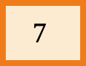
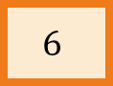
Efficient implementation Every vertex has a key and a parent
x
Can’t reach x yet
x
x is “active”
x
Can reach x
Until all the vertices are reached:
Activate the unreached vertex u with the smallest key.
for each of u’s neighbors v:
k[v] = min( k[v], weight(u,v) )
if k[v] updated, p[v] = u
Mark u as reached, and add (p[u],u) to MST.
k[x]
k[x] is the distance of x from the growing tree
a
b
p[b] = a, meaning that a was the vertex that k[b] comes from.
$$4$$
$$8$$
$$7$$
8
7
B
C
D
4
9
2
11
4
$$∞$$
A
I
$$2$$
14
E
0
7
6
8
10
1
2
H
G
F
$$7$$
$$6$$
$$4$$

Slide 60
Efficient implementation Every vertex has a key and a parent
x
Can’t reach x yet
x
x is “active”
x
Can reach x
Until all the vertices are reached:
Activate the unreached vertex u with the smallest key.
for each of u’s neighbors v:
k[v] = min( k[v], weight(u,v) )
if k[v] updated, p[v] = u
Mark u as reached, and add (p[u],u) to MST.
k[x]
k[x] is the distance of x from the growing tree
a
b
p[b] = a, meaning that a was the vertex that k[b] comes from.
$$4$$
$$8$$
$$7$$
8
7
B
C
D
4
9
2
11
4
$$∞$$
A
I
$$2$$
14
E
0
7
6
8
10
1
2
H
G
F
$$7$$
$$6$$
$$4$$

Slide 61
Efficient implementation Every vertex has a key and a parent
x
Can’t reach x yet
x
x is “active”
x
Can reach x
Until all the vertices are reached:
Activate the unreached vertex u with the smallest key.
for each of u’s neighbors v:
k[v] = min( k[v], weight(u,v) )
if k[v] updated, p[v] = u
Mark u as reached, and add (p[u],u) to MST.
k[x]
k[x] is the distance of x from the growing tree
a
b
p[b] = a, meaning that a was the vertex that k[b] comes from.
$$4$$
$$8$$
$$7$$
8
7
B
C
D
4
9
2
11
4
$$∞$$
A
I
$$2$$
14
E
0
7
6
8
10
1
2
H
G
F
$$7$$
$$6$$
$$4$$

Slide 62
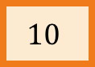
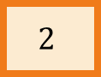
Efficient implementation Every vertex has a key and a parent
x
Can’t reach x yet
x
x is “active”
x
Can reach x
Until all the vertices are reached:
Activate the unreached vertex u with the smallest key.
for each of u’s neighbors v:
k[v] = min( k[v], weight(u,v) )
if k[v] updated, p[v] = u
Mark u as reached, and add (p[u],u) to MST.
k[x]
k[x] is the distance of x from the growing tree
a
b
p[b] = a, meaning that a was the vertex that k[b] comes from.
$$4$$
$$8$$
$$7$$
8
7
B
C
D
4
9
2
11
4
$$10$$
A
I
$$2$$
14
E
0
7
6
8
10
1
2
H
G
F
$$7$$
$$2$$
$$4$$

Slide 63
Efficient implementation Every vertex has a key and a parent
x
Can’t reach x yet
x
x is “active”
x
Can reach x
Until all the vertices are reached:
Activate the unreached vertex u with the smallest key.
for each of u’s neighbors v:
k[v] = min( k[v], weight(u,v) )
if k[v] updated, p[v] = u
Mark u as reached, and add (p[u],u) to MST.
k[x]
k[x] is the distance of x from the growing tree
a
b
p[b] = a, meaning that a was the vertex that k[b] comes from.
$$4$$
$$8$$
$$7$$
8
7
B
C
D
4
9
2
11
4
$$10$$
A
I
$$2$$
14
E
0
7
6
8
10
1
2
H
G
F
$$7$$
$$2$$
$$4$$

Slide 64
Efficient implementation Every vertex has a key and a parent
x
Can’t reach x yet
x
x is “active”
x
Can reach x
Until all the vertices are reached:
Activate the unreached vertex u with the smallest key.
for each of u’s neighbors v:
k[v] = min( k[v], weight(u,v) )
if k[v] updated, p[v] = u
Mark u as reached, and add (p[u],u) to MST.
k[x]
k[x] is the distance of x from the growing tree
a
b
p[b] = a, meaning that a was the vertex that k[b] comes from.
$$4$$
$$8$$
$$7$$
8
7
B
C
D
4
9
2
11
4
$$10$$
A
I
$$2$$
14
E
0
7
6
8
etc.
10
1
2
H
G
F
$$7$$
$$2$$
$$4$$

Slide 65
One thing that is similar: Running time
O(mlog(n)) using a Red-Black tree as a priority queue.

Slide 66
Two questions
Does it work?
That is, does it actually return a MST?
Yes!
How do we actually implement this?
the pseudocode above says “slowPrim”…

Slide 67
Kruskal Algorithm
Minimum Spanning Tree

Slide 68
That’s not the only greedy algorithm what if we just always take the cheapest edge? whether or not it’s connected to what we have so far?
8
7
B
C
D
4
9
2
11
4
A
I
14
E
7
6
8
10
1
2
H
G
F

Slide 69
That’s not the only greedy algorithm what if we just always take the cheapest edge? whether or not it’s connected to what we have so far?
8
7
B
C
D
4
9
2
11
4
A
I
14
E
7
6
8
10
1
2
H
G
F

Slide 70
That’s not the only greedy algorithm what if we just always take the cheapest edge? whether or not it’s connected to what we have so far?
8
7
B
C
D
4
9
2
11
4
A
I
14
E
7
6
8
10
1
2
H
G
F

Slide 71
That’s not the only greedy algorithm what if we just always take the cheapest edge? whether or not it’s connected to what we have so far?
8
7
B
C
D
4
9
2
11
4
A
I
14
E
7
6
8
10
1
2
H
G
F

Slide 72
That’s not the only greedy algorithm what if we just always take the cheapest edge? whether or not it’s connected to what we have so far?
8
7
B
C
D
4
9
2
11
4
A
I
14
E
7
6
8
10
1
2
H
G
F

Slide 73
That’s not the only greedy algorithm what if we just always take the cheapest edge? whether or not it’s connected to what we have so far?
8
7
B
C
D
4
9
2
11
4
A
I
14
E
7
6
8
10
1
2
H
G
F

Slide 74
That’s not the only greedy algorithm what if we just always take the cheapest edge? whether or not it’s connected to what we have so far?
That won’t cause a cycle
8
7
B
C
D
4
9
2
11
4
A
I
14
E
!!!!!
7
6
8
10
1
2
H
G
F

Slide 75
That’s not the only greedy algorithm what if we just always take the cheapest edge? whether or not it’s connected to what we have so far?
That won’t cause a cycle
8
7
B
C
D
4
9
2
11
4
A
I
14
E
7
6
8
10
1
2
H
G
F

Slide 76
That’s not the only greedy algorithm what if we just always take the cheapest edge? whether or not it’s connected to what we have so far?
That won’t cause a cycle
8
7
B
C
D
4
9
2
11
4
A
I
14
E
7
6
8
10
1
2
H
G
F

Slide 77
That’s not the only greedy algorithm what if we just always take the cheapest edge? whether or not it’s connected to what we have so far?
That won’t cause a cycle
8
7
B
C
D
4
9
2
11
4
A
I
14
E
7
6
8
10
1
2
H
G
F

Slide 78
That’s not the only greedy algorithm what if we just always take the cheapest edge? whether or not it’s connected to what we have so far?
That won’t cause a cycle
8
7
B
C
D
4
9
2
11
4
A
I
14
E
7
6
8
10
1
2
H
G
F

Slide 79
We’ve discovered Kruskal’s algorithm!
slowKruskal(G = (V,E)):
Sort the edges in E by non-decreasing weight.
MST = {}
for e in E (in sorted order):
if adding e to MST won’t cause a cycle:
add e to MST.
return MST
m iterations through this loop
How do we check this?
How would you figure out if added e would make a cycle in this algorithm?
Naively, the running time is ???:
For each of m iterations of the for loop:
Check if adding e would cause a cycle…

Slide 80
Two questions
Does it work?
That is, does it actually return a MST?
How do we actually implement this?
the pseudocode above says “slowKruskal”…
Let’s do this one first

Slide 81
At each step of Kruskal’s, we are maintaining a forest.
A forest is a collection of disjoint trees
8
7
B
C
D
4
9
2
11
4
A
I
14
E
7
6
8
10
1
2
H
G
F

Slide 82
At each step of Kruskal’s, we are maintaining a forest.
A forest is a collection of disjoint trees
8
7
B
C
D
4
9
2
11
4
A
I
14
E
7
6
8
10
1
2
H
G
F

Slide 83
At each step of Kruskal’s, we are maintaining a forest.
A forest is a collection of disjoint trees
When we add an edge, we merge two trees:
8
7
B
C
D
4
9
2
11
4
A
I
14
E
7
6
8
10
1
2
H
G
F

Slide 84
At each step of Kruskal’s, we are maintaining a forest.
A forest is a collection of disjoint trees
When we add an edge, we merge two trees:
8
7
B
C
D
4
9
2
11
4
A
I
14
E
7
6
8
10
1
2
H
G
F

Slide 85
At each step of Kruskal’s, we are maintaining a forest.
A forest is a collection of disjoint trees
When we add an edge, we merge two trees:
8
7
B
C
D
4
9
2
11
4
A
I
14
E
7
6
8
10
1
2
H
G
F
We never add an edge within a tree since that would create a cycle.

Slide 86
Keep the trees in a special data structure
“treehouse”?

Slide 87
Union-find data structure also called disjoint-set data structure
Used for storing collections of sets
Supports:
makeSet(u): create a set {u}
find(u): return the set that u is in
union(u,v): merge the set that u is in with the set that v is in.
makeSet(x)
makeSet(y)
makeSet(z)
union(x,y)
x
y
z

Slide 88
Union-find data structure also called disjoint-set data structure
Used for storing collections of sets
Supports:
makeSet(u): create a set {u}
find(u): return the set that u is in
union(u,v): merge the set that u is in with the set that v is in.
makeSet(x)
makeSet(y)
makeSet(z)
union(x,y)
x
y
z

Slide 89
Union-find data structure also called disjoint-set data structure
Used for storing collections of sets
Supports:
makeSet(u): create a set {u}
find(u): return the set that u is in
union(u,v): merge the set that u is in with the set that v is in.
makeSet(x)
makeSet(y)
makeSet(z)
union(x,y)
find(x)
x
y
z

Slide 90
Kruskal pseudo-code
kruskal(G = (V,E)):
Sort E by weight in non-decreasing order
MST = {} // initialize an empty tree
for v in V:
makeSet(v) // put each vertex in its own tree in the forest
for (u,v) in E: // go through the edges in sorted order
if find(u) != find(v): // if u and v are not in the same tree
add (u,v) to MST
union(u,v) // merge u’s tree with v’s tree
return MST

Slide 91
Once more…
To start, every vertex is in its own tree.
8
7
B
C
D
4
9
2
11
4
A
I
14
E
7
6
8
10
1
2
H
G
F

Slide 92
Once more…
Then start merging.
8
7
B
C
D
4
9
2
11
4
A
I
14
E
7
6
8
10
1
2
H
G
F

Slide 93
Once more…
Then start merging.
8
7
B
C
D
4
9
2
11
4
A
I
14
E
7
6
8
10
1
2
H
G
F

Slide 94
Once more…
Then start merging.
8
7
B
C
D
4
9
2
11
4
A
I
14
E
7
6
8
10
1
2
H
G
F

Slide 95
Once more…
Then start merging.
8
7
B
C
D
4
9
2
11
4
A
I
14
E
7
6
8
10
1
2
H
G
F

Slide 96
Once more…
Then start merging.
8
7
B
C
D
4
9
2
11
4
A
I
14
E
7
6
8
10
1
2
H
G
F

Slide 97
Once more…
Then start merging.
8
7
B
C
D
4
9
2
11
4
A
I
14
E
7
6
8
10
1
2
H
G
F

Slide 98
Once more…
Then start merging.
8
7
B
C
D
4
9
2
11
4
A
I
14
E
7
6
8
10
1
2
H
G
F

Slide 99
Once more…
Stop when we have one big tree!
Then start merging.
8
7
B
C
D
4
9
2
11
4
A
I
14
E
7
6
8
10
1
2
H
G
F

Slide 100
Running time
Sorting the edges takes O(m log(n))
In practice, if the weights are small integers we can use radixSort and take time O(m)
For the rest:
n calls to makeSet
put each vertex in its own set
2m calls to find
for each edge, find its endpoints
n calls to union
we will never add more than n-1 edges to the tree,
so we will never call union more than n-1 times.
Total running time:
Worst-case O(mlog(n)), just like Prim.
Closer to O(m) if you can do radixSort
In practice, each of makeSet, find, and union run in constant time*

Slide 101
Two questions
Does it work?
That is, does it actually return a MST?
How do we actually implement this?
the pseudocode above says “slowKruskal”…
Worst-case running time O(mlog(n)) using a union-find data structure.
Now that we understand this “tree-merging” view, let’s do this one.

Slide 102
Does it work?
We need to show that our greedy choices don’t rule out success.
That is, at every step:
There exists an MST that contains all of the edges we have added so far.
Now it is time to use our lemma!
again!

Slide 103
Lemma
Let S be a set of edges, and consider a cut that respects S.
Suppose there is an MST containing S.
Let (u,v) be a light edge.
Then there is an MST containing S $∪$ {(u,v)}
This edge is light
B
8
C
D
7
4
9
2
11
4
A
I
14
E
8
7
6
10
H
1
G
2
F
S is the set of thick orange edges

Slide 104
Partway through Kruskal
Assume that our choices S so far are safe.
they don’t rule out success
The next edge we add will merge two trees, T1, T2
8
7
B
C
D
4
9
2
11
4
A
I
14
E
8
7
6
10
S is the set of
edges selected so far.
H
1
G
2
F

Slide 105
Partway through Kruskal
Assume that our choices S so far are safe.
they don’t rule out success
The next edge we add will merge two trees, T1, T2
Consider the cut {T1, V – T1}.
A respects this cut.
Our new edge is light for the cut
This is the next edge
8
7
B
C
D
4
9
2
11
4
A
I
14
E
8
7
6
10
S is the set of
edges selected so far.
H
1
G
2
F

Slide 106
Partway through Kruskal
Assume that our choices S so far are safe.
they don’t rule out success
The next edge we add will merge two trees, T1, T2
Consider the cut {T1, V – T1}.
A respects this cut.
Our new edge is light for the cut
This is the next edge
By the Lemma, that edge is safe.
it also doesn’t rule out success.
8
7
B
C
D
4
9
2
11
4
A
I
14
E
8
7
6
10
S is the set of
edges selected so far.
H
1
G
2
F

Slide 107
Hooray!
Our greedy choices don’t rule out success.
This is enough (along with an argument by induction) to guarantee correctness of Kruskal’s algorithm.

Slide 108
Formally(ish)
This is exactly the same slide that we had for Prim’s algorithm.
Inductive hypothesis:
After adding the t’th edge, there exists an MST with the edges added so far.
Base case:
After adding the 0’th edge, there exists an MST with the edges added so far. YEP.
Inductive step:
If the inductive hypothesis holds for t (aka, the choices so far are safe), then it holds for t+1 (aka, the next edge we add is safe).
That’s what we just showed.
Conclusion:
After adding the n-1’st edge, there exists an MST with the edges added so far.
At this point we have a spanning tree, so it better be minimal.

Slide 109
Two questions
Does it work?
That is, does it actually return a MST?
Yes
How do we actually implement this?
the pseudocode above says “slowKruskal”…
Using a union-find data structure!

Slide 110
What have we learned?
Kruskal’s algorithm greedily grows a forest
It finds a Minimum Spanning Tree in time O(mlog(n))
if we implement it with a Union-Find data structure
To prove it worked, we followed the same recipe for greedy algorithms we saw last time.
Show that, at every step, we don’t rule out success.

Slide 111
Comparison of Kruskal and Prims

Slide 112
Compare and contrast
Prim:
Grows a tree.
Time O(mlog(n)) with a red-black tree
Kruskal:
Grows a forest.
Time O(mlog(n)) with a union-find data structure
If you can do radixSort on the edge weights, morally O(m)
Prim might be a better idea on dense graphs
Kruskal might be a better idea on sparse graphs if you can radixSort edge weights

Slide 113
Both Prim and Kruskal
Greedy algorithms for MST.
Similar reasoning:
Optimal substructure: subgraphs generated by cuts.
The way to make safe choices is to choose light edges crossing the cut.
This edge is light
B
8
C
D
7
4
9
2
11
4
A
I
14
E
8
7
6
10
H
1
G
2
F
S is the set of thick orange edges

Slide 114
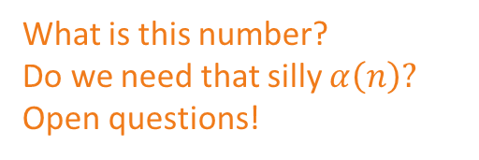
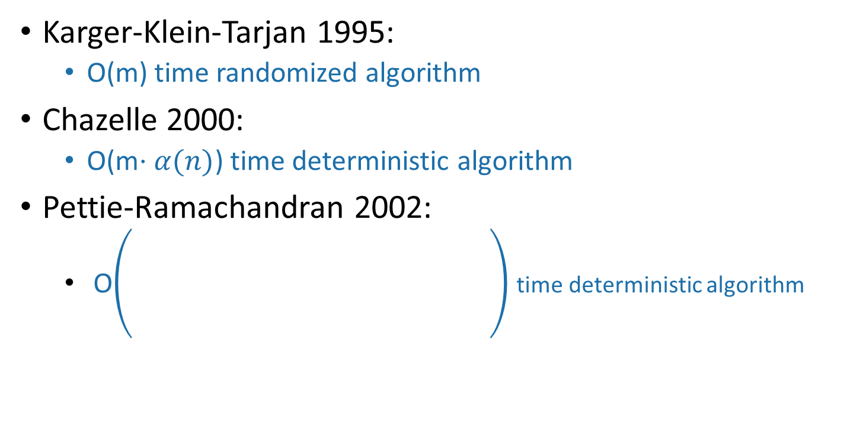
Can we do better? State-of-the-art MST on connected undirected graphs
Karger-Klein-Tarjan 1995:
O(m) time randomized algorithm
Chazelle 2000:
O(m$⋅α(n)$) time deterministic algorithm
Pettie-Ramachandran 2002:
O time deterministic algorithm
The optimal number of comparisons N*(n,m) you need to solve the problem, whatever that is…
What is this number?
Do we need that silly $α\left(n\right)?$
Open questions!

Slide 115
Recap
Two algorithms for Minimum Spanning Tree
Prim’s algorithm
Kruskal’s algorithm
Both are (more) examples of greedy algorithms!
Make a series of choices.
Show that at each step, your choice does not rule out success.
At the end of the day, you haven’t ruled out success, so you must be successful.

